Slide 1

TEAM 11
Citadel Data Open West Coast Regional

Slide 2
Executive Summary
Data Exploration
Research Proposal
Modeling & Analysis
Conclusions
Appendix
Topic Question
Understanding the inter-temporal behavioral differences in movie reviewers, and how such traits may vary across different types of movies.
Background & Motivation
Summary of Analysis
In the current age of connectivity and information, reading reviews and ratings have become an indispensable routine of consumer behavior. As we approach the Second Golden Age of television with the influx of quality movies and shows, consumers are faced with the impossibility of
Insights

Slide 3
Executive Summary
Data Exploration
Research Proposal
Modeling & Analysis
Conclusions
Appendix
Topic Question
Understanding the inter-temporal behavioral differences in movie reviewers, and how such traits may vary across different types of movies.

Slide 4
Executive Summary
Data Exploration
Research Proposal
Modeling & Analysis
Conclusions
Appendix
Dataset Usage & Data Wrangling
58098 rows x 3 columns (movieId, title, genres)
Dataset containing all movies for analysis, cross-referenced with ratings dataset using movieId; genre features were analyzed
title came in the form of "title (year)" e.g. Avengers, The (2012). Year was extracted and added to a new column release
title format did not correspond to other datasets e.g. Avengers, The would appear as The Avengers in movie_industry. This was resolved through string formatting prior to performing an inner join with movie_industry, so as to obtain industry metadata on selected movies
genres came in the form of “genre1|genre2|genre3…” as a string. One-hot encoding was done for all movies and genres, producing 16 binary columns representing genres.
We further subset movies which are released from 1996 onwards, since ratings data begin continuously from Jan 1996 (1995 has 1 month of data), and we are interested in the duration between movie release and rating.
movies.csv
movie_industry.csv
6820 rows x 15 columns (budget, name, etc…)
Dataset containing popular movies and industry metadata, used for feature exploration
ratings.csv
28M rows x 4 columns (userId, movieId, rating, timestamp)
Dataset with all ratings info together with timestamp
timestamps were converted from seconds since epoch to pandas datetime format for ease of timing comparison and grouping
genome-tags.csv
genome-scores.csv
tags: 1128 rows x 2 columns (tagId, itemId)
scores: 15M rows x 3 columns (movieId, tagId, relevance)

Slide 5
Executive Summary
Data Exploration
Research Proposal
Modeling & Analysis
Conclusions
Appendix
Feature Engineering
Ratings Dataset
With the ratings dataset, we engineered the following features: user_rating, months_delta
user_rating: the average rating given by the user throughout his movie ratings in the dataset (unique to each userId)
months_delta: the number of months elapsed from the timestamp of the movie’s first rating in the dataset until the timestamp of the rating (unique to each rating)
Movies Datasets
The ratings features were further grouped by months_delta for each movie, allowing us to calculate the mean monthly ratings of each movie
In a similar way, usermeanrating was produced as the monthly mean user_rating data for every movie, given the reviewers who reviewed that movie in that specific month
For movies in movie_industry, we calculated the profit margin of movies as (gross - budget / gross)
Tags Dataset
We noticed that the 1128 tags were not vastly different (e.g. “zombie”, “zombies”). As such we used principal component analysis to reduce the 1128 tags to 100 tags, retaining 80% of variance

Slide 6
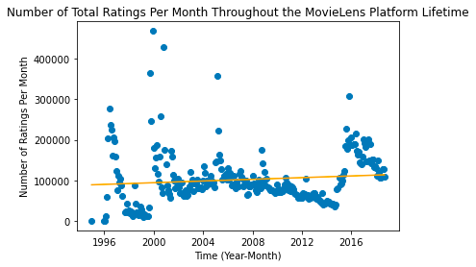
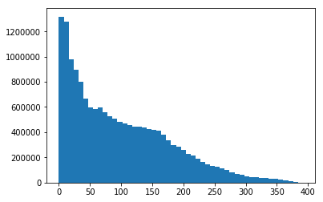
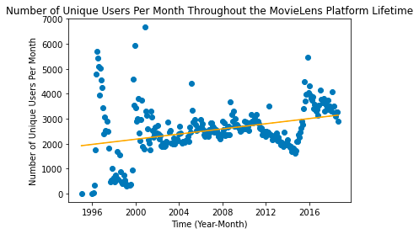
Executive Summary
Data Exploration
Research Proposal
Modeling & Analysis
Conclusions
Appendix
Exploratory Data Analysis
MovieLens Usage Trend
“Early Adopters, Late Majority, and Laggards”
Aggregate rating count after movie release date
We first began our data exploration by plotting rating information from the MovieLens dataset, as potential increasing trends (as the rating platform becomes more popular over time) or seasonality effects might skew our analysis pipeline.
By plotting rating count and unique users per month over time and performing a simple linear regression, we conclude that there is no significant trend and cyclicality in terms of platform popularity and usage.
Rating count
Months after movie release
Using the release date information in movie_industry.csv, we created a subset of 4012 movies released after 1995. For this subset, we found 1,714,6188 corresponding ratings, and using their timestamp information, grouped them based on the months elapsed from the release date of their corresponding movie. The above histogram was then produced.
We were surprised to find that the ratings submitted within 1 year of a movie’s release did not constitute a significant majority of the entire database; instead, a notable percentage of consumers continued watching and reviewing movies many years after the movie’s release.
Based on this, we hypothesized that there may be differences in consumer behavior between early watchers and late watchers, which may potentially arise from contextual differences such as watching a movie in the cinema v.s. on TV/online, being a fan for a specific movie v.s. being a casual watcher.

Slide 7
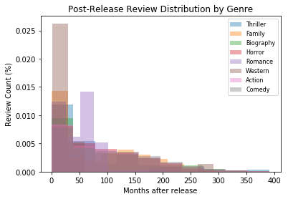
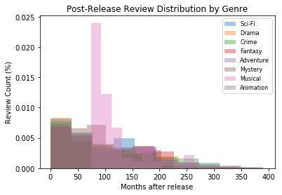
Executive Summary
Data Exploration
Research Proposal
Modeling & Analysis
Conclusions
Appendix
Exploratory Data Analysis
Cross-Genre Inter-temporal Differences
Following our general investigation on the time-series distribution of movie reviewers after the release date of a movie, we investigated how such distributions may differ across genres. Using the “genre” column in movie_industry, we classified ratings based on genres, and plotted the distribution density of 16 genres in the 2 plots below.
Through visual analysis, we can see that most genres get about <1% of their total ratings in the first 2 years of their release, with a gradual decline over the next ~10 years (240 months).
Interesting outliers include:
Western: 2.5% of total ratings are registered within the first 2 years of the movie’s release, followed by an immediate decline
Romance: Rating frequency peak at 1.5% after around 4 years of the movies release.
Musical: Rating frequency peak significantly at 2.5% after around 6 years from the movie’s release, with a gradual decline for 6 more years.
These outliers and trends may suggest that inter-temporal consumer behavior may vary across genres. For example, the abnormal frequency peak of the musicals genre may suggest that these movies have high rewatch value, and people do not mind watching them outside theaters.
Rating frequency
Rating frequency

Slide 8
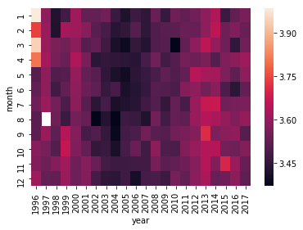
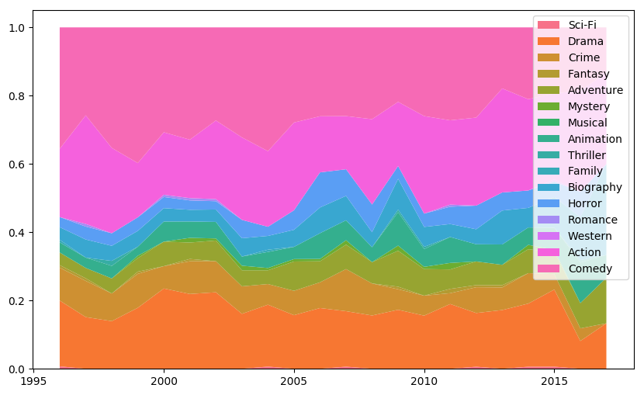
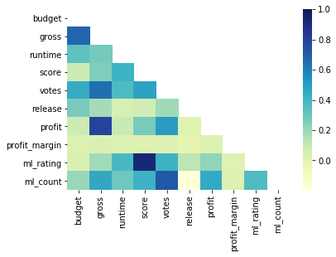
Executive Summary
Data Exploration
Research Proposal
Modeling & Analysis
Conclusions
Appendix
Exploratory Data Analysis
Average Monthly Rating over Time
Movie Category Trend
Movie Feature Correlation
Correlation
Average Rating
Genre Ratio
Release Year
To identify potential seasonality effects of consumer behavior within the span of our dataset, we plotted the above heat map and found that there is no clear seasonality trend across the years, apart from the minor observation that raters were slightly more critical between 2004 to 2007.
Given the genre data from movie_industry, we investigated the distribution of movie genres from 1996 to 2016. We see that comedy, action, and drama are the most frequent movies across all these years, with other genres consistently occupying a smaller percentage.
In understanding the various numeric features in both the MovieLens and movie_industry datasets, we observed that the there is high correlation between the MovieLens average rating (ml_rating) and the score in the movie_industry data. As such we decided to drop the movie_industry score. Similarly, gross correlates highly with profit (an engineered feature) and budget, thus we decided to drop this feature too since it is already captured by profit and profit_margin.

Slide 9
Executive Summary
Data Exploration
Research Proposal
Modeling & Analysis
Conclusions
Appendix
Topic Question
Understanding the inter-temporal behavioral differences in movie reviewers, and how such traits may vary across different types of movies.
Firstly, we wish to understand how the general perception of a movie change over time. The key proxy for general perception is the average monthly rating of a movie. We hypothesize that two factors are associated with the monthly ratings of a movie:
Time elapsed between movie’s release and rating
We hypothesize that the characteristic of reviewers differ across time, leading to self-selection of rating types and biases.
For example, the consumers rating a movie within the first few months of its release may have always wanted to watch the movie since its announcement, or really enjoy the cinema experience, whereas consumers rating a movie many years after its release may only have stumbled upon the movie on Netflix, and/or viewed it on a smaller screen.
General profile of reviewers rating the movie in a given month
We hypothesize that the general profile of reviewers, that is how the average reviewer in a group rates an average movie, has a high impact on the monthly rating of the movie. This measures variability across different reviewer types.
Secondly, having gained initial insights from the impact of time on monthly movie ratings, we wish to further investigate how such impacts might differ across movie categories and related features, such as genres.
We hypothesize that the inter-temporal impact of movie ratings differ across types of movies
For example, the initial ratings from a franchise-movie (e.g. MCU) might be abnormally high compared to the rest of its time-series data given initial hype and franchise perception, leading to a notable decline over time; in contrast, certain categories of movies may be considered “hidden gems”, and only gets popular after an initial dormant period, when it resurfaces on streaming platforms.

Slide 10
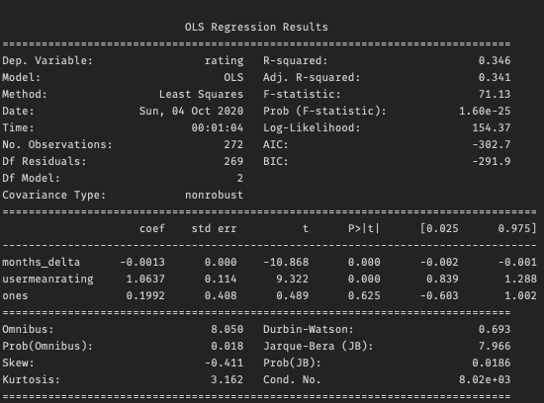
Executive Summary
Data Exploration
Research Proposal
Modeling & Analysis
Conclusions
Appendix
Model 1: Multiple Linear Regression to Predict Monthly Average Rating
Model Explanation
This example results shows that months_delta has a slight negative impact on monthly mean ratings, suggesting that the mean monthly ratings decreased over time
The >1 usermeanrating suggests that this particular movies is one which raters on average tend to rate higher than their usual rating behavior
The low p-values associated with both variables suggest high predictability of both factors
monthly mean rating of a specific movie
months_delta: number of months since first movie was first rated
usermeanrating: mean user rating across users who rated the movie in the given month
We used multiple linear regression to assess the impacts of two variables on the monthly mean rating of movies
We used this model for every movie in our movie dataset that was released during and after 1996, had at least 24 months of ratings data (since factors such as theatrical release, award shows are likely most evident within the first 12 months; our earlier rating count graph also showed that rating count began decreasing significantly after 24 months), and at least 500 ratings, using ordinary least squares
Example OLS results from one movie: Toy Story

Slide 11
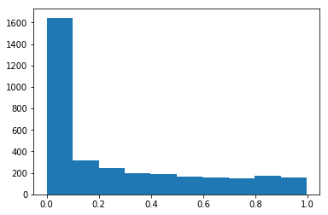
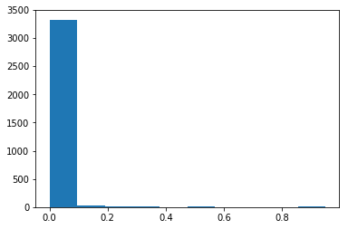
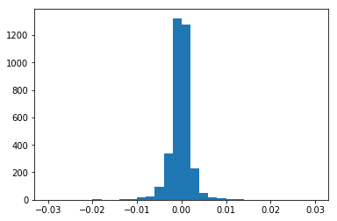
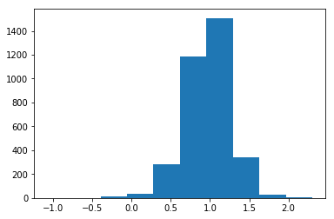
Executive Summary
Data Exploration
Research Proposal
Modeling & Analysis
Conclusions
Appendix
Model 1: Multiple Linear Regression to Predict Monthly Average Rating
months_delta
Although each movie has a different set of months_delta data, varying from 24 months to 200+ months, we find that the p-value distribution of months_delta across these movies suggest that the latency of movie ratings do have a significant effect on the monthly mean ratings of a movie.
There is an almost even split on the direction of this impact, with a slightly negative skew.
This suggests that the monthly ratings of a movie tend to decrease, which might be explained by factors such as self-selection of early watchers, and the positive effect of cinema experience.
Nonetheless, the variability of these coefficients warrants further genre and feature based analysis.
usermeanratings
p-value distribution for months_delta
p-value distribution for usermeanratings
The distribution of p-values from usermeanratings suggests that the average user rating across all movies given by users rating a specific movie in a month has a highly predictive impact on the monthly rating of that movie.
That the distribution of coefficients is largely positive and centered around 1.0 suggests that most movies in this subset are within user expectations, with some movies either exceeding or going below expectations.
Movie count
Movie count
p-value
p-value
Coefficient value distribution for months_delta
Coefficient value distribution for usermeanratings
Movie count
Movie count
Coefficient value
Coefficient value

Slide 12
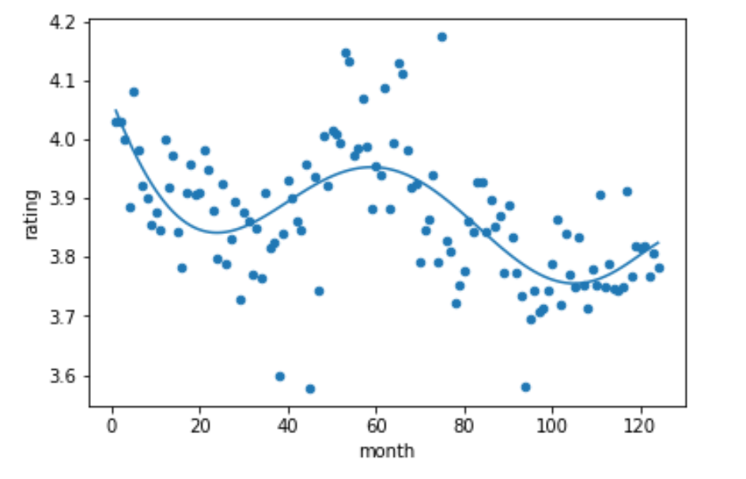
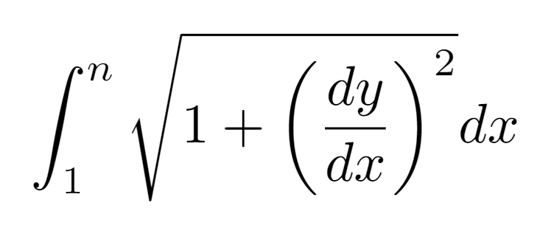
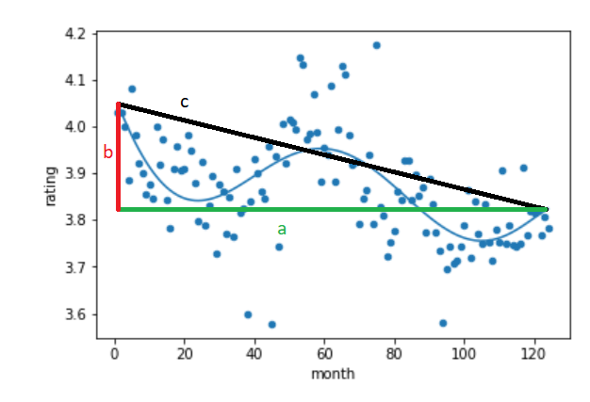
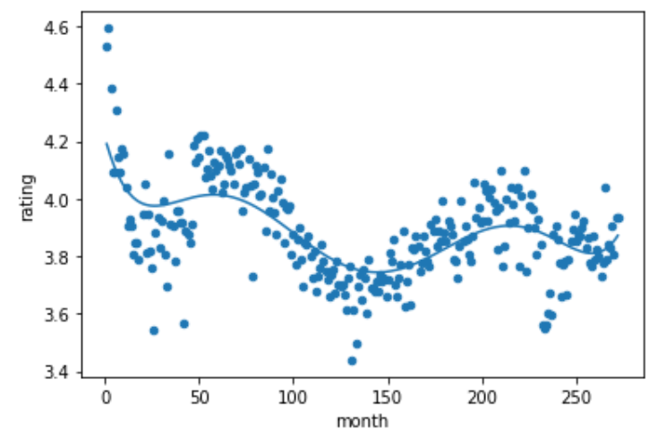
Executive Summary
Data Exploration
Research Proposal
Modeling & Analysis
Conclusions
Appendix
Model 2: Predicting Total Movie Rating Variability Over Time
When investigating average movie ratings as a function of time, we found some intriguing relationships. We contemplated several ways of quantifying the shape of the relationship, including the degree of the polynomial that best fit the data (using regularized linear regression), the total variation in the ratings over time, the location of extrema, average months between extrema, etc.
We decided that the two best ways to capture the intricate relationships in our data are to compute the total variation in the function that best fit the data, as well as the net rating change over time.
We fit the ratings data for each movie with a sixth degree polynomial to capture as much of the relationship as possible without overfitting. We investigated a few movies and consistently found that the polynomial relationship in the data did not exceed degree six.
We calculated the total variation in the fit polynomial as the arc length from 1 month to n months. We then divided the calculated arc length, s, by length of the diagonal, c where c² = a² + b², to standardize the arc lengths between movies (regardless of net rating change and length of time). This method, as opposed to simply calculating the total variation in ratings, is insulated against random variation. We want our model to capture only the significant variance in the relationship between ratings and time in a movie.
We used net rating change as our second metric to gauge the general rating shift over time. We calculated this as f(n) - f(1), where f is the fit polynomial. We again used our polynomial of best fit to calculate this metric as insulation against random variation.
The arc length of a function. For our analysis, y(x) is ratings as a function of time.
Ratings over time for Iron Man.
Ratings over time for Toy Story.
We standardized the arc lengths by the diagonal length, c, to reduce the impact of the net rating change and time length.

Slide 13
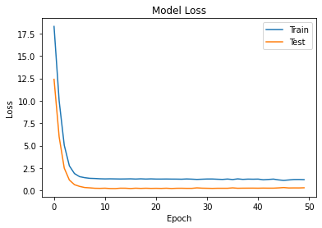
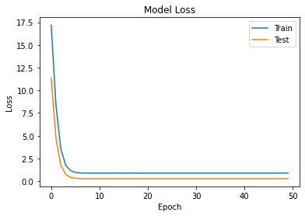
Executive Summary
Data Exploration
Research Proposal
Modeling & Analysis
Conclusions
Appendix
Model 2: Predicting Total Movie Rating Variability Over Time --NO MORE MODEL 2
After engineering these two features, standardized arc length and net rating change, we predicted them using neural networks. We created two independent prediction models, one for predicting standardized arc length, which we will call model one, and one for predicting net rating change, which we will call model two. We decided that significant variables to use were ____.
Our final training accuracy and test accuracy for model one were ___, and ___, respectively. Our final training accuracy and test accuracy for model two were ___, and ___, respectively.
From our results, we can conclude that ___.
Plot of training and validation loss over epochs for model one.
Plot of training and validation loss over epochs for model two.
Plot of training and validation loss over epochs for model two.

Slide 14

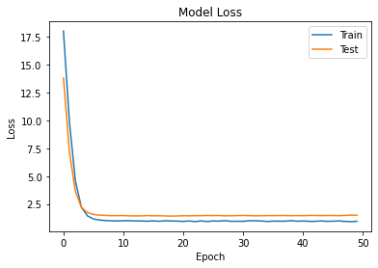
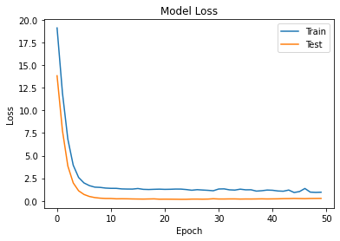

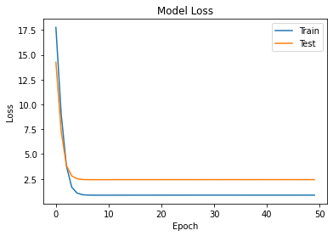
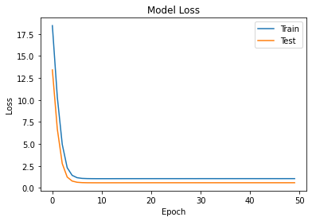
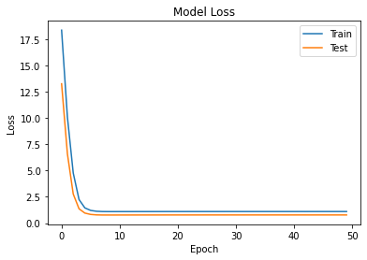
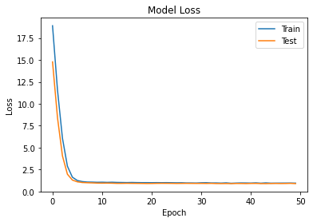
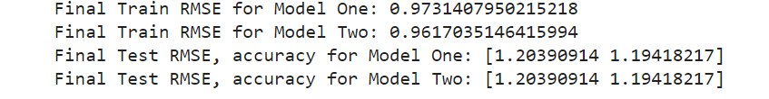
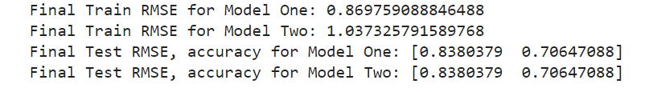
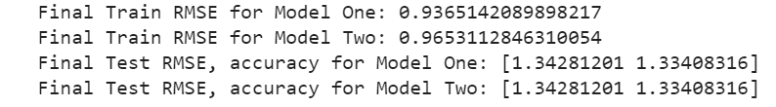
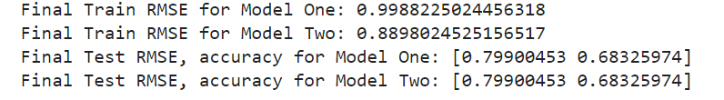
Executive Summary
Data Exploration
Research Proposal
Modeling & Analysis
Conclusions
Appendix
Model 2: Predicting Total Movie Rating Variability Over Time --NO MORE MODEL 2
Months = 4
Months = 12
Months = 24
Months = 60

Slide 15
Executive Summary
Data Exploration
Research Proposal
Modeling & Analysis
Conclusions
Appendix
Model 2: Predicting Total Movie Rating Variability Over Time
Implications of our research are ___

Slide 16
Executive Summary
Data Exploration
Research Proposal
Modeling & Analysis
Conclusions
Appendix
Scrapped Topic: Netflix/Oscar Effect
We also attempted to investigate the phenomenon known as the “Intervention Effect”, where viewership of movies drastically changes when an event brings certain movies to the spotlight, such as a movie being released on a streaming platform or a particular actor being nominated for an award. For example, this is observed when a movie from long ago is reintroduced on Netflix, resulting in a huge spike in viewers and reviews for that movie overall. Although this idea initially sounded promising, after working with the provided datasets and supplemental Netflix datasets, we realized that we couldn’t come to a proper conclusion for two reasons.
>First, we always observed peaks in viewership in 2015 and 2016 for movies released on Netflix. However, we found that the data on the platform itself were noisy, which contributes to excess noise when running our models. This also made it difficult to conduct frequency analyses on the data, since the noise altered the inputs almost every time.
>Second, we had too little data we could use to run our models and analyze them. In fact, there were less than 1000 movies that exhibited this particular effect. This made it difficult to formulate any sort of conclusion since there would be high variability in the data.

